Slide 1
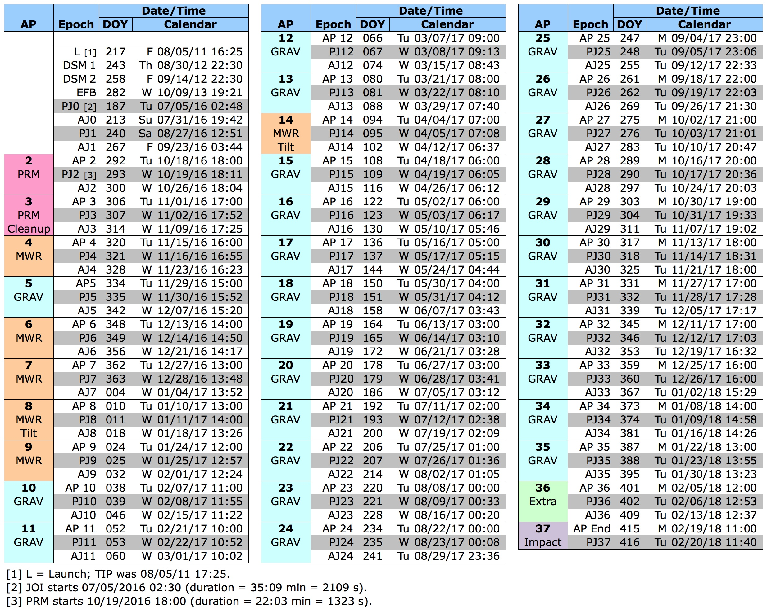
Trajectory Event Times (150326 reference trajectory)

